Slide 1



Think Tank: Knowledge Center for Employees
Welcome to the Tripura Gramin Bank Think Tank, your central knowledge hub designed to empower every employee. This initiative supports skill development and fosters information sharing, ultimately enhancing performance and driving bank growth.

Slide 2
Purpose and Role of the Think Tank
The Tripura Gramin Bank Think Tank serves as a strategic knowledge ecosystem designed to transform our workforce into skilled professionals and innovative thinkers. Our mission is to create a collaborative environment where employees can access resources, share expertise, and develop capabilities that directly contribute to the bank's growth and customer service excellence.
Knowledge Repository
Skill Development Hub
Innovation Catalyst
Centralized access to best practices, policies, procedures, and industry insights to ensure consistent service delivery across all branches.
Comprehensive training programs, certification courses, and professional development opportunities tailored to banking operations and customer service.
Platform for idea generation, process improvement suggestions, and collaborative problem-solving to drive operational efficiency and customer satisfaction.
By fostering a culture of continuous learning and knowledge sharing, the Think Tank empowers every employee to contribute meaningfully to Tripura Gramin Bank's mission of serving rural communities with excellence and innovation.

Slide 3

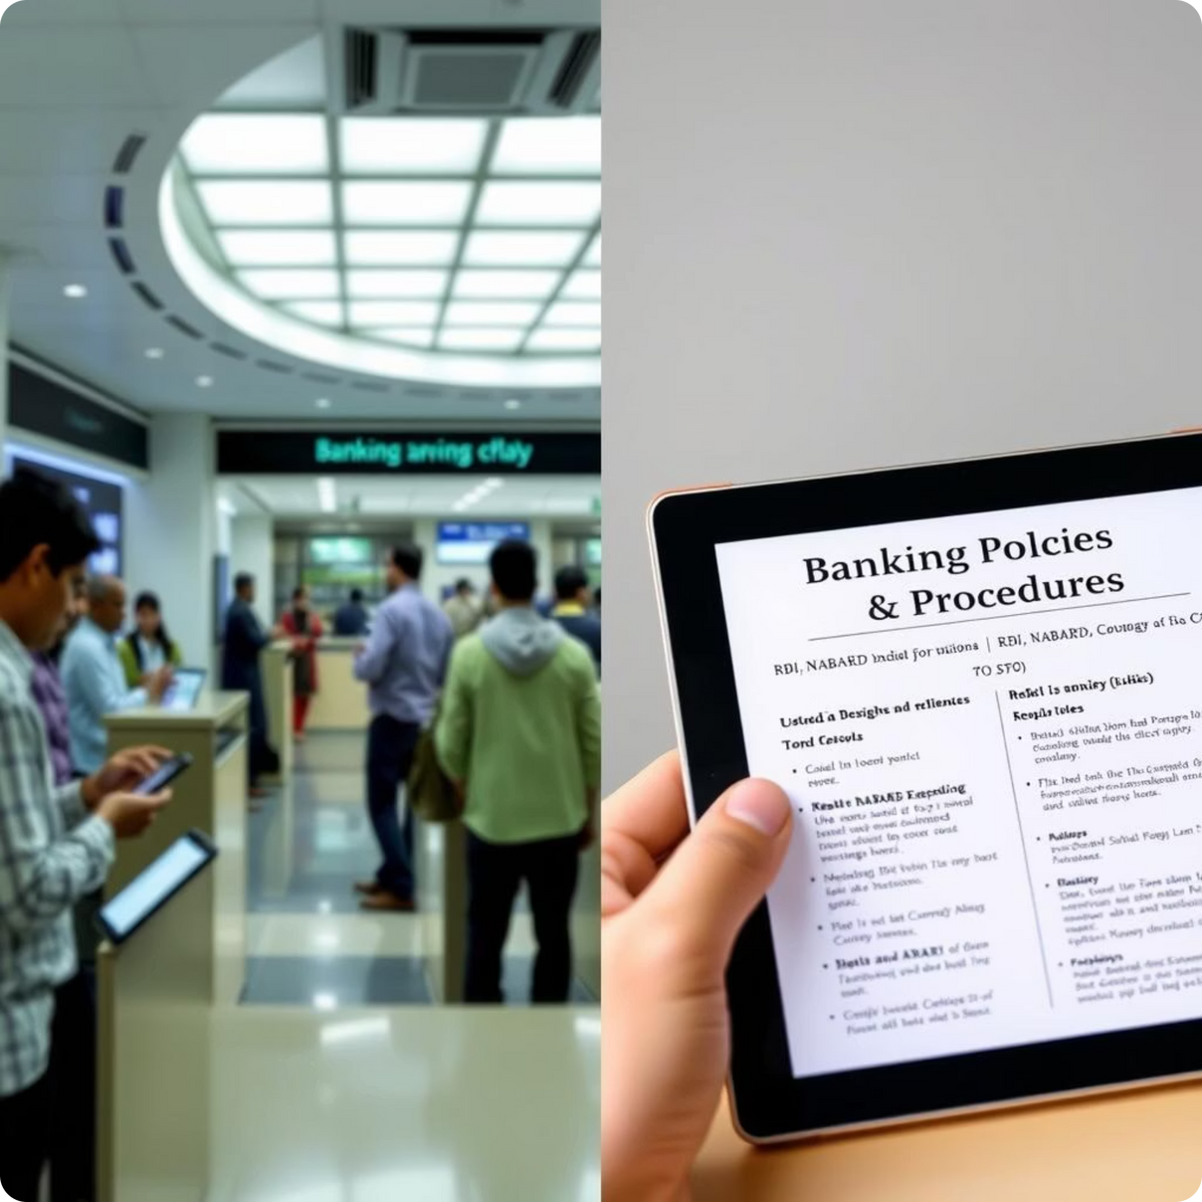

Key Features and Services
Information Access
Collaboration & Learning
  Updated banking policies and procedures.
  Interactive forums for cross-departmental discussions.
  Repository of best practices and case studies.
  Regular webinars and workshops information coming soon.

Slide 4

Employee Engagement and Benefits
  Empowerment
  Collaboration
  Enhanced Service Excellence
  Career Advancement

Slide 5
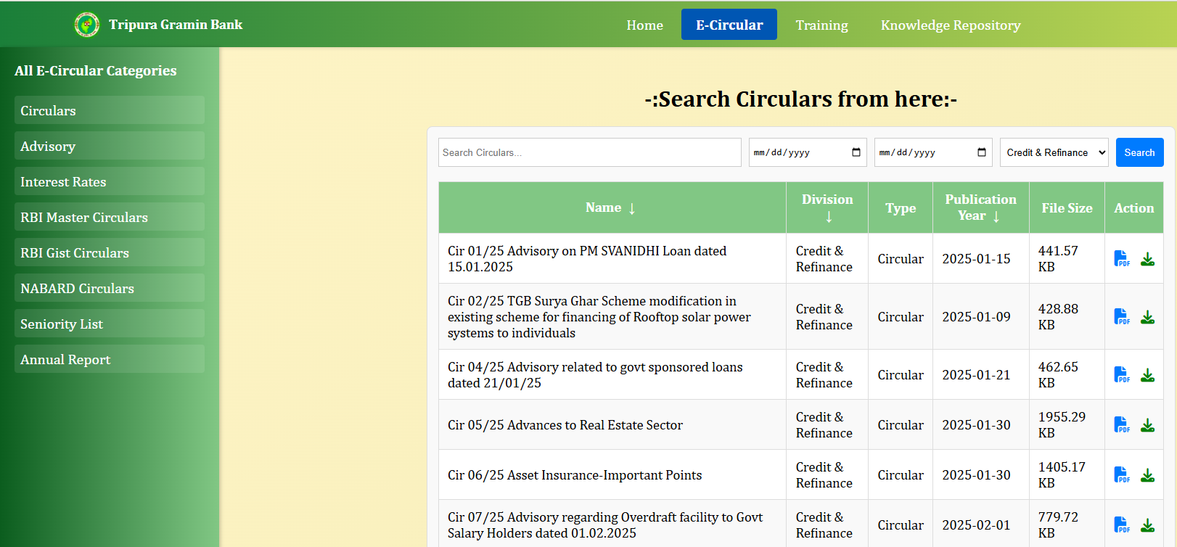
Empowerment
Provides timely information and essential circulars to all employees.

Slide 6
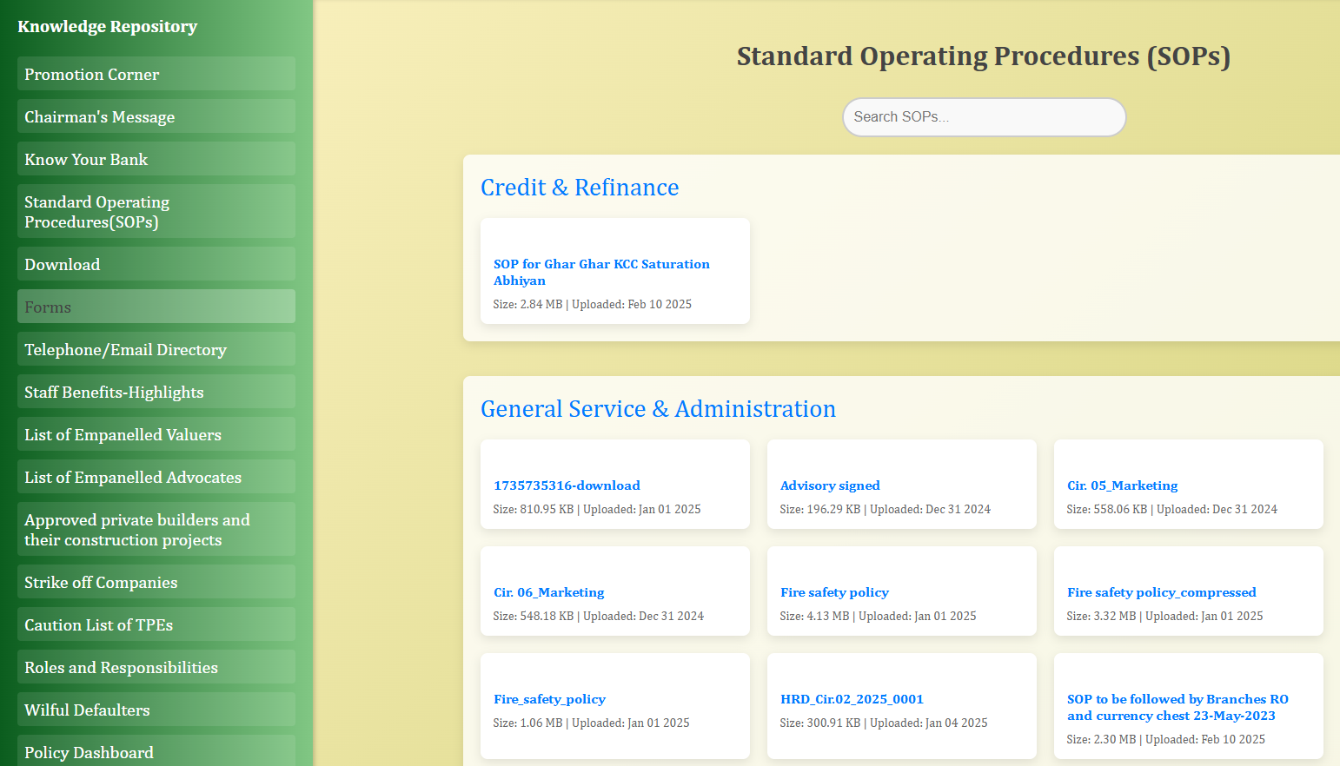
  Career Growth
  Supports continuous career growth and professional development

Slide 7
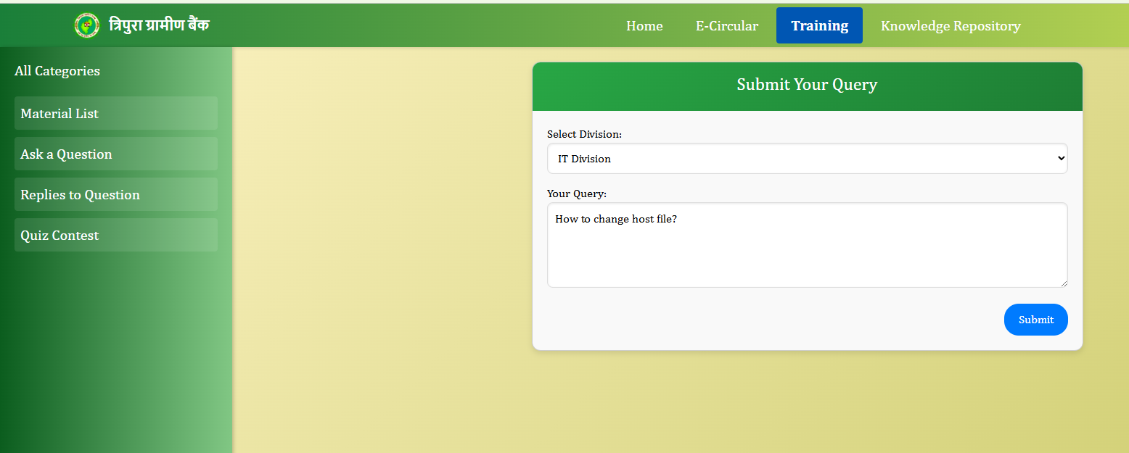
  Collaboration
  Encourages seamless collaboration across 150 branches statewide.

Slide 8
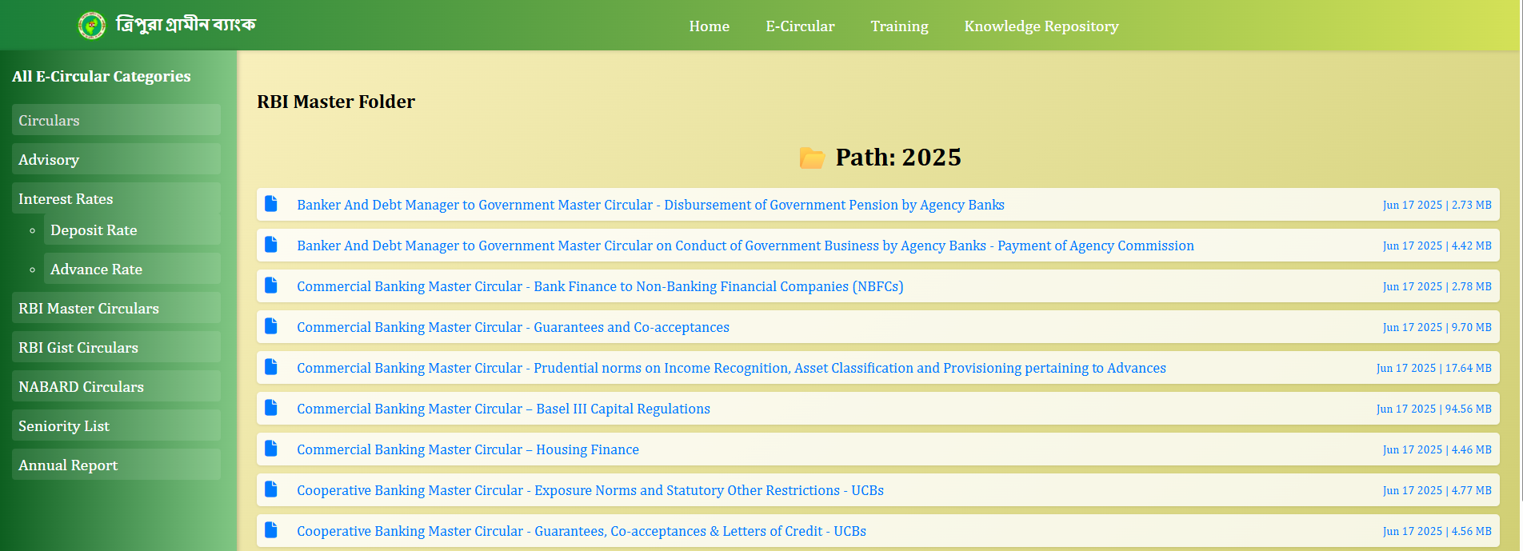
  Improved Service
  Enhances decision-making and elevates customer service quality as per the regulatory norms

Slide 9
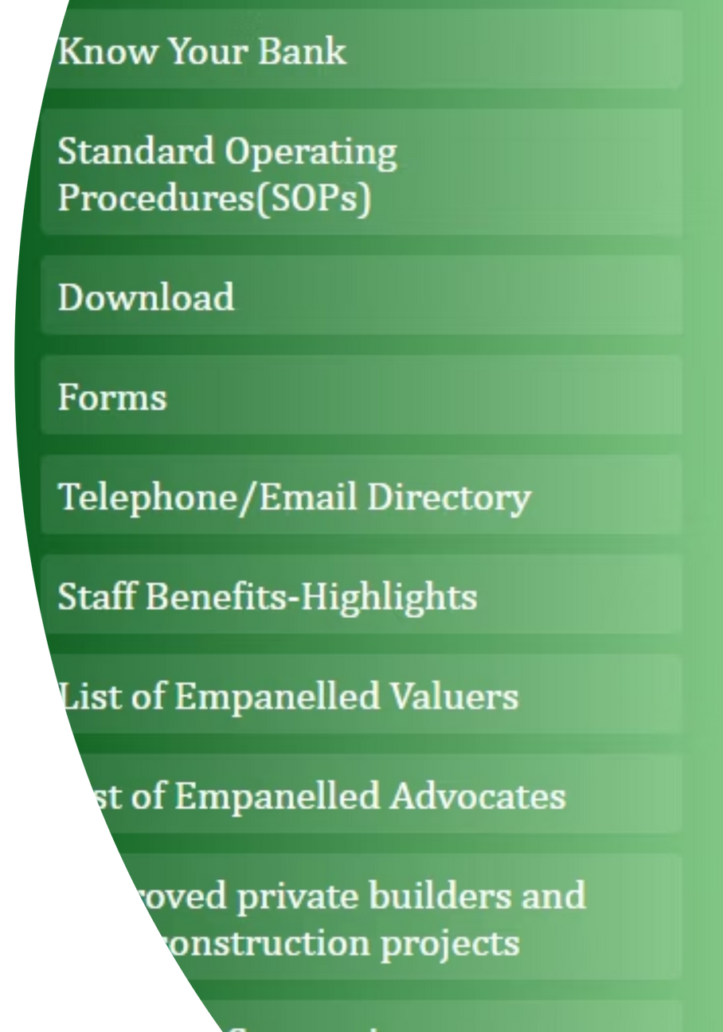




Technology and Resources
Digital Platform: Accessible to all employees via a user-friendly interface.
Knowledge Exchange: Ask questions and gain knowledge from any department across all 150 branches.
Interactive Learning: Participate in quizzes, assessments, and knowledge competitions.
Continuous Updates: Content is regularly updated to align with the latest regulatory changes and industry standards.

Slide 10


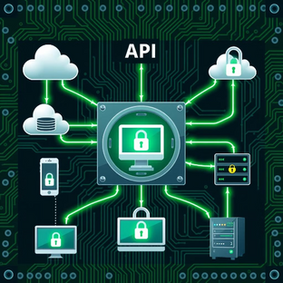
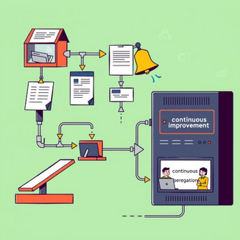
Future Plans and Development
Content Expansion
AI-Driven Learning
API Integration
Improved Feedback Mechanisms
We are looking at API integration to make it more secure and enhance system reliability.
Expand content to cover emerging banking trends and financial technologies.
Incorporate AI-driven personalized learning paths for tailored development.
Strengthen feedback mechanisms to ensure continuous improvement and relevance.

Slide 11

Conclusion: Empowering Employees, Driving Growth
The Tripura Gramin Bank Think Tank is the vital knowledge backbone supporting our mission to uplift the rural economy through a skilled and empowered workforce. It fosters innovation, collaboration, and excellence, serving as a key enabler for sustainable bank performance and enhanced customer trust.

Slide 12
Thank you!

